Slide 1
Chapter 9
PAIRED-SAMPLE T TEST

Slide 2
Paired-Samples t Test
z test and single-sample t test compare a sample to a population, but…
often we want to compare 2 (or more) samples
  Does processing a word in terms of meaning produce better retention than processing a word in terms of its appearance?
  Does Treatment X decrease depression?

Slide 3
Paired-Samples t Test
Used to compare two means for a within-groups design
Within-groups design?
  all participants experience every level of the IV
  pre-test, post-test
  “before”, “after”

Slide 4
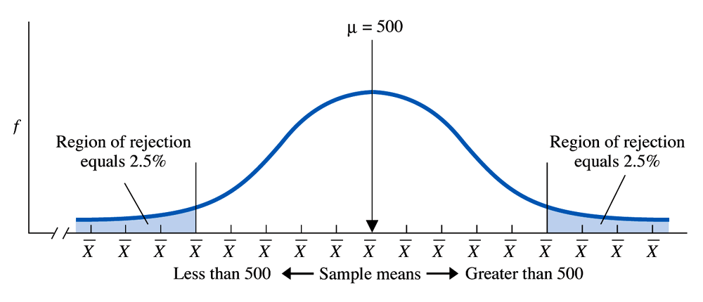
Modified Sampling Distribution
Paired-samples t test relies on a sampling distribution of means differences
μ_{M} = 0
D D D D D D D D 0 D D D D D D D D

Slide 5
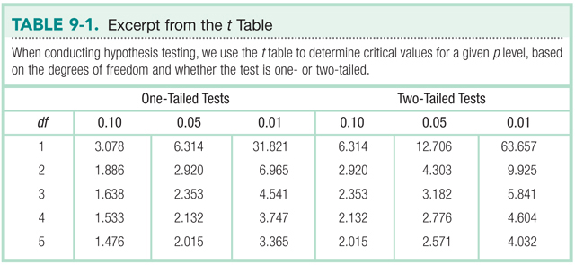
The t Table

Slide 6
Example
A researcher counted the number of aggressive encounters among children who were playing with worn and broken toys. Next, the children watched other children playing with new, shiny toys. Finally, the first group of children resumed playing with the worn and broken toys, and the researcher again counted the number of aggressive encounters
  Based on Barker, Dembo, & Lewin (1941).

Slide 7
Data (number of aggressive encounters)
Before (X) | After (Y)
16 | 18
10 | 11
17 | 19
4 | 6
9 | 10
12 | 14

Slide 8
Step 1: Identify
Populations
  Children playing with broken toys
  Children playing with broken toys after being exposed to other children with nicer toys
Comparison distribution
  distribution of mean differences
Hypothesis test
  paired-samples t test
Assumptions
  DV is scale
  Convenience sample
  N = 6

Slide 9
Step 2: H₀ & H₁
H₀ : No difference between populations
  H₀ : μ₁ = μ₂
H₁ : There is a difference between populations
  H₁ : μ₁ ≠ μ₂

Slide 10
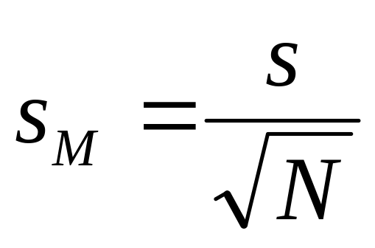
Step 3: Identify the Sampling Distribution
μ_{M} = 0

Slide 11
Data (number of aggressive encounters)
Before (X) | After (Y) | Difference | Dif - M_{dif} | (Dif – M_{dif})²
16 | 18 | -2 | -0.33 | 0.11
10 | 11 | -1 | 0.67 | 0.45
17 | 19 | -2 | -0.33 | 0.11
4 | 6 | -2 | -0.33 | 0.11
9 | 10 | -1 | 0.67 | 0.45
12 | 14 | -2 | -0.33 | 0.11
M_{dif} = -1.67
SS = 1.34

Slide 12
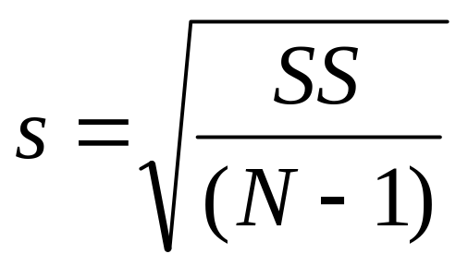
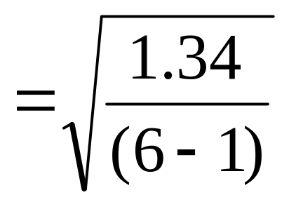
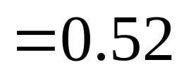
Calculating s

Slide 13
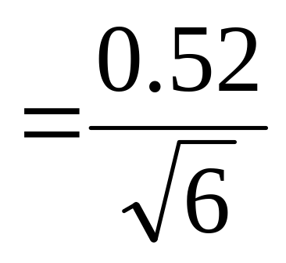
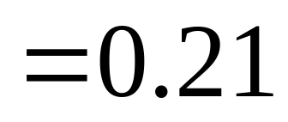
Calculating s_{M}

Slide 14
Step 3: Identify the Sampling Distribution
μ_{M} = 0
s_{M} = 0.21

Slide 15
Step 4: Determine Critical Values
Two-tailed, α = .05
df = N – 1 = 6-1 = 5

Slide 16
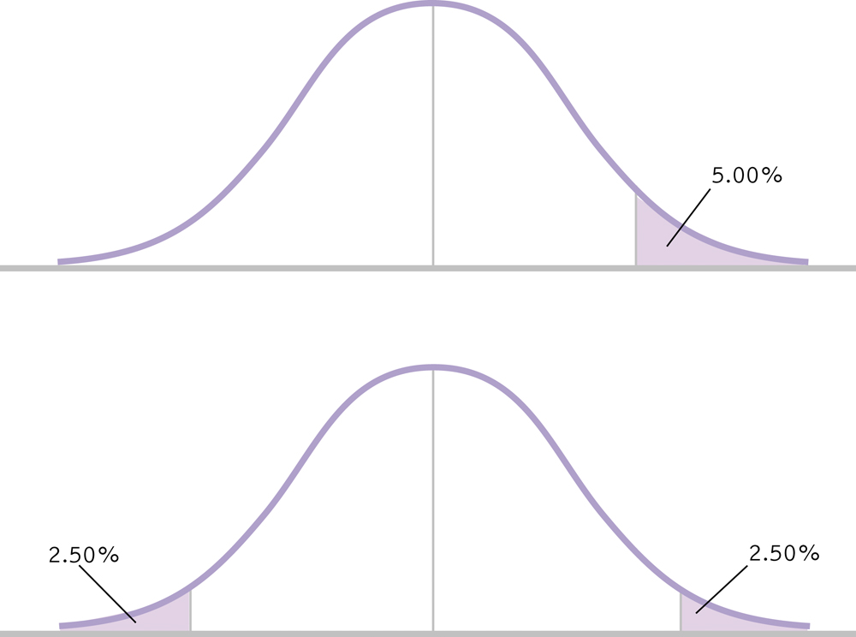
Step 4: Determine Critical Values
Two-tailed, α = .05
-2.571
2.571

Slide 17
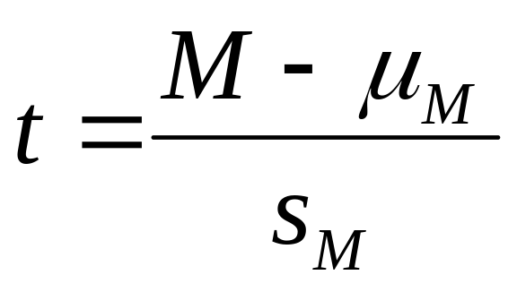
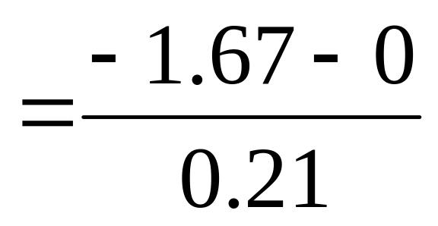
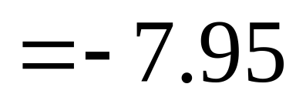
Step 5: Calculate t

Slide 18
Step 6: Make a Decision
Is the calculated t in the rejection region?
-7.95
-2.571
2.571

Slide 19
Step 6: Make a Decision
Reject H₀
Children were significantly more aggressive after watching others play with nicer toys, t(5)=-7.95, p<.05.
  M_{X} = 11.33
  M_{Y} = 13

Slide 20
Confidence Intervals
M_{lower} = - t(s_{M}) + M_{sample} M_{upper} = t(s_{M}) + M_{sample}
=- 2.571(0.21) – 1.67 = 2.571(0.21) – 1.67
= -2.21 = -1.13

Slide 21
Confidence Interval
95% confidence interval is [-2.21, -1.13]
This interval would contain the population mean difference 95% of the time
The population mean difference between aggression before and after watching other kids play with nicer toys is likely between -2.21 and -1.13

Slide 22
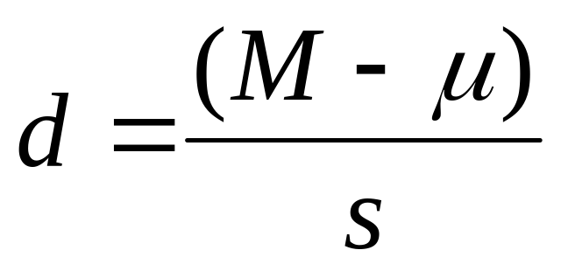
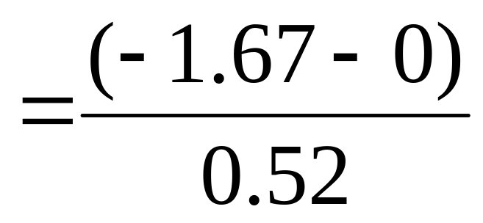
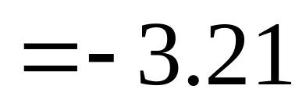
Effect Size

